Slide 1


Unicorn Performance Analysis 2015- 2018
Presented by : Masterschool March’ 24 Project Team:
Akilan Sivanandham, Leela Yathapu, Rama al Homsi, Tsai-Shiou and Vani Prasad
Welcome to our comprehensive analysis of Unicorn, a family-owned e-commerce platform that has steady growth over the past two decades with a diverse range of products: books, office supplies, clothing, electronics, furniture, household items.
This presentation covers the comprehensive analysis using sales data from 2015 to 2018.
Notes:
Welcome everyone, today we will be presenting the performance analysis of unicorn, an e-commerce platform, covering the period from 2015 - 2018

Slide 2
Project Objectives
Analyse Sales Data
Identify Strengths and weakness
Highlight the growth and opportunities.
Notes:
Our Project objectives are threefold: to analyse the sales data, identify strengths and weaknesses in business operations, and highlight opportunity for growth and profitability.

Slide 3
Approach
Explore with SQL
Data cleaning using google Sheets
Gaining insight with Tableau
Notes:
Our approach includes exploring data with SQL, performing data cleaning using Google sheets and using Tableau for exploratory and Data Analysis

Slide 4
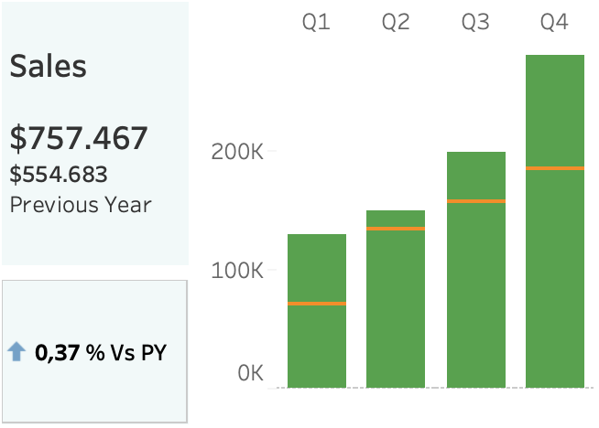
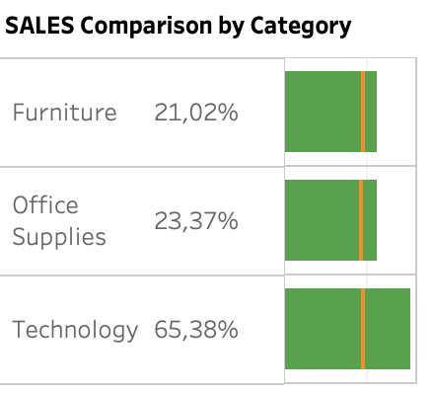
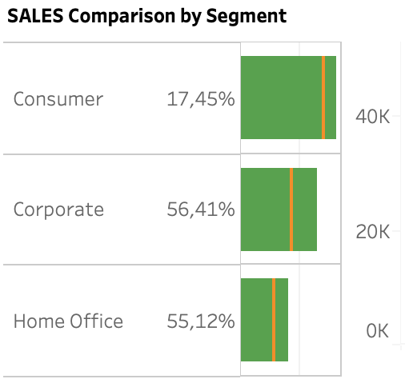
Key Insights - Sales Performance
Total Sales (2018): $757,467 (Growth: 0.37%)
Quarterly Sales Growth with Q4 spike
Profits changes by category and segment:
Technology increased profits, while furniture and office supplies declined in profits.
Profits from consumers declined 20% from 2017 - 2018
Notes:
Total sales for 2018 reached $757,467, reflecting a growth of 0.37% from the previous year. Sales showed consistent growth across all quarters with a significant spike in Q4. Technology led in sales by category, while the Corporate segment dominated by sales segment.

Slide 5
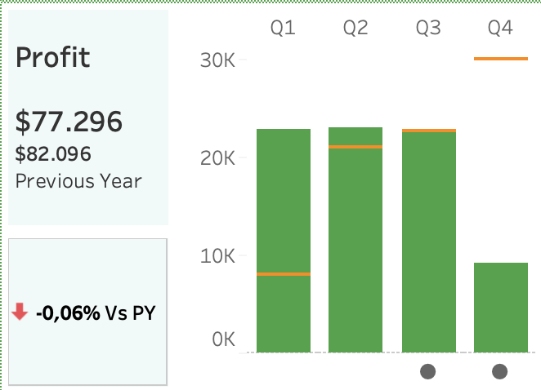
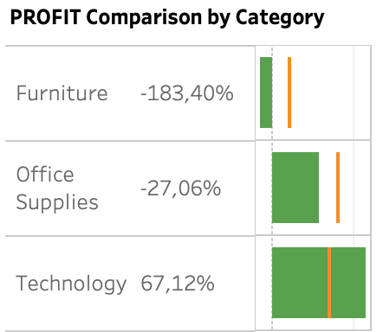
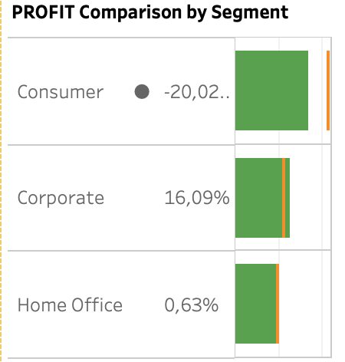
Key Insights - Profit Performance
Total Profit (2018): $77,296 (Negative Growth: -0.06%)
Quarterly Profit Trends
Profit by Shipping Method
Notes:
The total profit for 2018 was $77,296, which is slightly down from the previous year, showing a negative growth rate of -0.06%. Profits also showed an upward trend throughout the quarters, with the highest in Q4. It’s essential to analyze the impact of different shipping methods on profit margins.

Slide 6
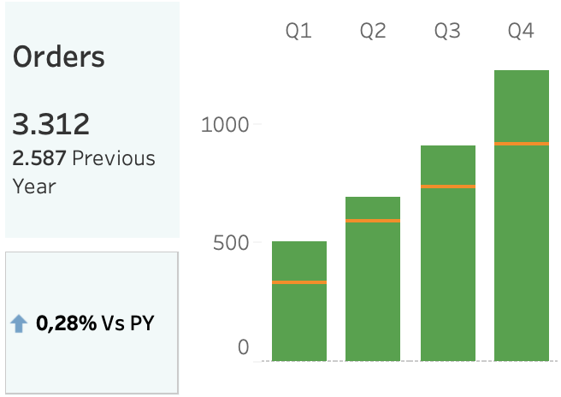
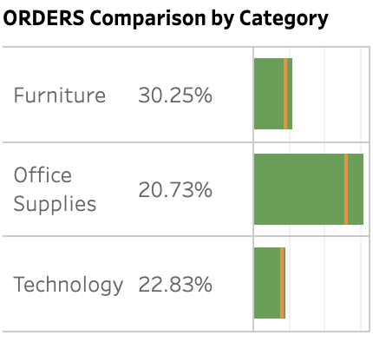
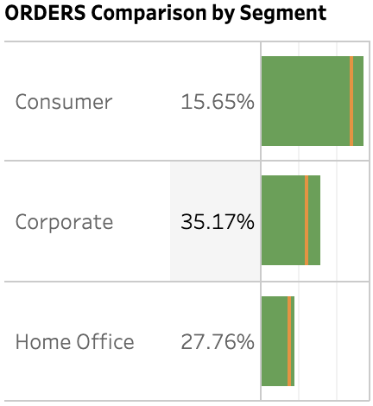
Key Insights - Order Performance
Total Orders (2018): 3,312 (Growth: 0.28%)
Quarterly Orders Growth with Q4 peak
Top Products by Sales
Notes:
The number of orders in 2018 increased to 3,312 from 2,587 in the previous year, indicating a growth rate of 0.28%. Orders have consistently grown each quarter, peaking in Q4. Top products include advanced copiers and electric binding systems.

Slide 7
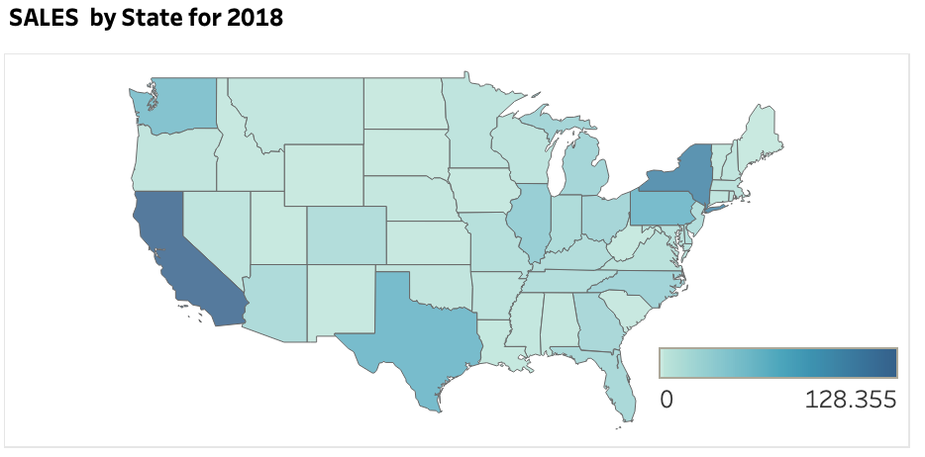
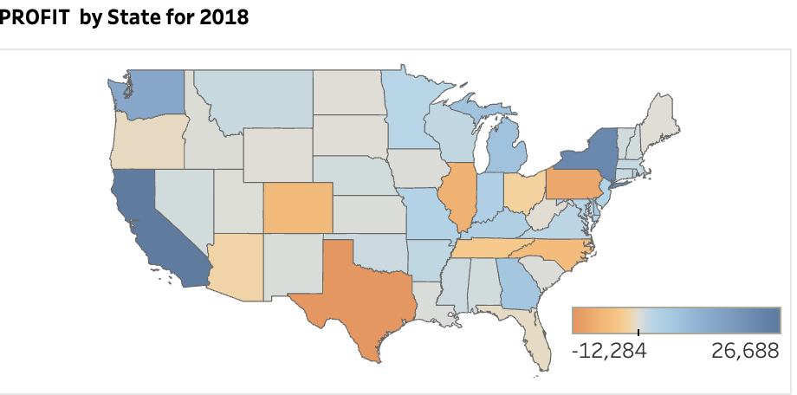
Key Insights - Geographical Distribution
High-Performing Regions: West & South
Low-Performing Regions: Central
Regional Sales Comparison
Notes:
"Western Region, particularly major States, show the highest sales and orders, indicating strong market penetration. Conversely, ess densely populated areas show lower sales figures, presenting an opportunity for targeted marketing."

Slide 8
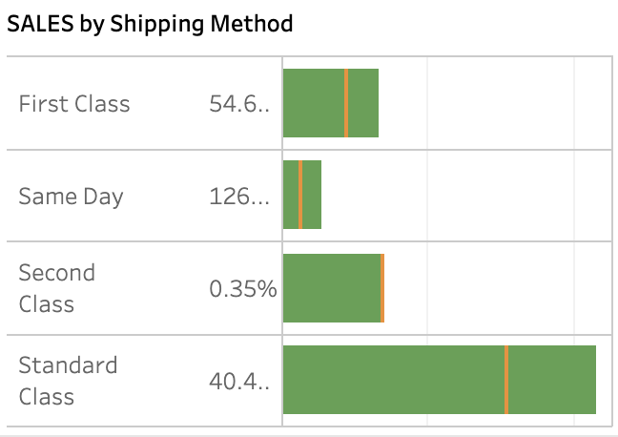
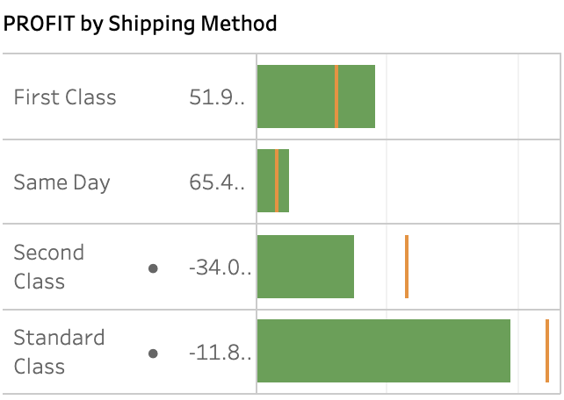
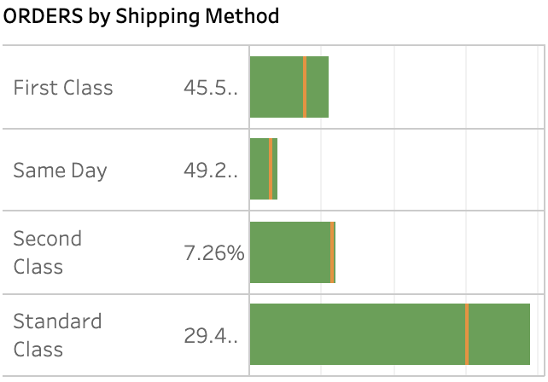
Key Insights - Impact of Shipping Methods
Preferred Shipping Methods: Standard Class
Analysis of Shipping Data for Optimization
Notes:
"Most customers preferred Standard Class shipping over others. Analyzing shipping data can help optimize logistics, enhance customer satisfaction, manage costs effectively, and drive better business outcomes"

Slide 9
Key Insights - Recommendations
Further analyze the profitability in furniture and office supplies, refine product selections in the two categories.
Identify the root cause of profit drop in the consumers segment by conducting market research.
Strengthen customer engagement initiatives, particularly for the Corporate and Home Office segments, to boost repeat purchases and customer loyalty.
Implementing targeted marketing campaigns, introducing new products or enhancing existing ones.
Leverage data analytics to continually monitor performance, identify trends, and make informed decisions to support business growth.
Notes:
"Our recommendations include conducting a thorough review of operational costs, implementing targeted marketing campaigns, introducing new products or enhancing existing ones, strengthening customer engagement initiatives, and leveraging data analytics for informed decision-making
"

Slide 10


Project Team
Project Links: SQL Spreadsheet Tableau1 Tableau2 Presentation Executive Summary Team Members: Akilan Sivanandham Leela Yathapu Rama Al homsi Tsai-Shiou Hsieh Vani Prasad
Notes:
"Lastly, I'd like to acknowledge our project team: Akilan, Leela, Rama, Tsai, and Vani, for their dedication and hard work in this comprehensive analysis."

Slide 11
Key Insights
Q&A

